Slide 1
Chapter 5: Gaits and Cyclic Motion
Howie Choset

Slide 2
Motion planning
Find shape inputs to move system between two configurations

Slide 3
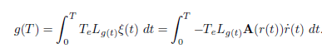
Motion Planning
Given the local connection, could we just define a path through the world, and then use
(inverse kinematics with a matrix pseudoinverse) to determine the shape trajectories?

Slide 4
Motion Planning
Inverse kinematics not always sufficient:
1. Constrained directions – only certain paths are admissible
2. Singularities, Sinks, and Joint limits: what’s wrong with these?
Kinematic snake can’t pass through singularities at “C” shapes
Three-link swimmer can’t move laterally from this shape
General motion planning needs “look ahead” to workaround these problems
Notes:
Any motion that says you have you pass throgh a1=a2 violates a singulaty. We like to call these shapes C shapes. Signularites are bad because 1) you may need infinite energy to passt hrough 2) you could end up in a sink where you have no escape and 3) from a numeric perspective, you may sample before and then after the singulatity and give the impression that all is ok when it is not.
Maybe ask kids in the class for examples of looking ahead. Ross likes the create a cycle to get around a sink

Slide 5
Motion Planning
Full optimal control requires solving whole path at once (respecting constraints, limits, etc.)
Maneuver-based planning precalculates short paths that
1. Avoid joint limits and singularities
2. Displace the system in some “useful” manner
3. Can be concatenated together to form a longer motion plan

Slide 6
Gaits
Gaits are cyclic motions in the shape space
Cyclic nature makes them inherently composable

Slide 7
Nonconservativity and Noncommutativity
Kinematic gaits operate on two basic principles:
Nonconservatvity: System pulls itself forward more than it pushes itself backward each cycle
Noncommutativity: System rotates during the course of the gait, so forward and backward motions do not directly cancel
Notes:
If you have motion that has only a nonconservative contribution, then each row of the connection is independet of each other
That is not necessarily true and the noncommuitative constribtiob captures that.

Slide 8
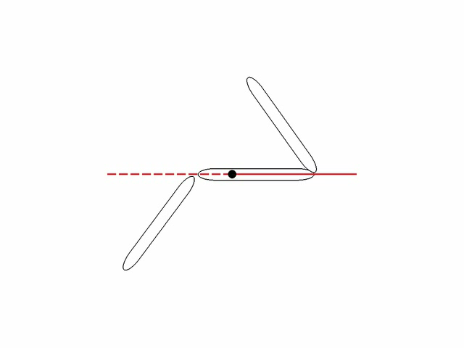
Nonconservativity Example
Gait “flows against” field more than it “flows with” it, and thus has net negative rotation.

Slide 9
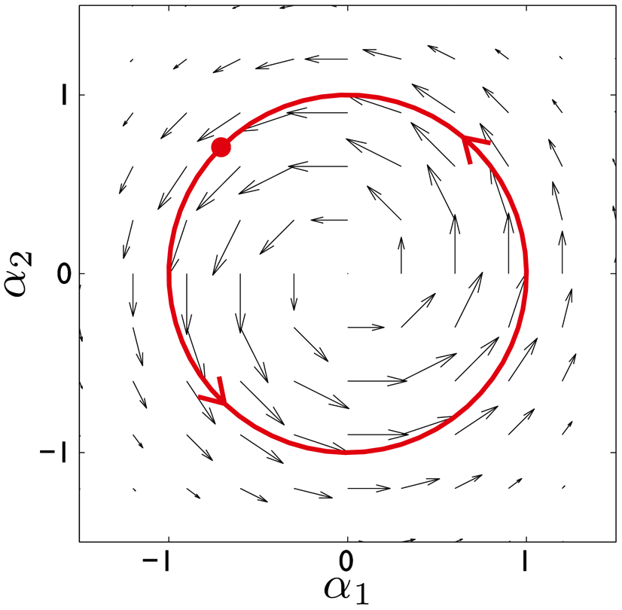
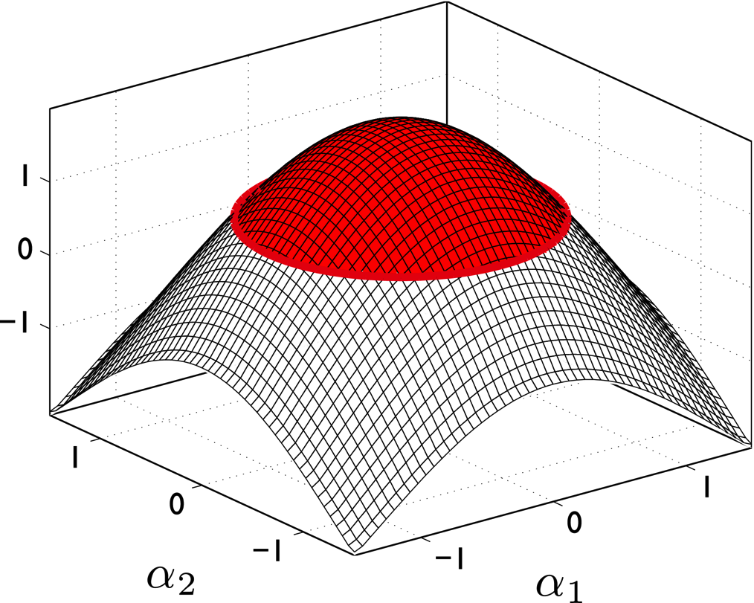
Stokes’s Theorem (vector calculus version)
Line integral of a closed path on a vector field is equal to the area integral of the field’s curl

Slide 10
Curl
Curl is sometimes described as “how much the vector field is ‘rotating’ around a point”
Magnitude also comes in here, so this description can be somewhat confusing
Another way to think of it is “the derivatives of the vector components along orthogonal directions in the space”
Around a cycle, line integrals on top right and bottom left fields will cancel, but those on top left and bottom right will not. Curl measures this non-canceling
Notes:
V is the vectorfield
u_1 is the x-coord
u_2 is the y-coord
v_1 is the x comp of V, which could be a function of u_1 and u_2
v_2 is the y comp of V, which could be a function of u_1 and u_2
Line integral in a loop in a vectorfield. Every point has an antipotal point. We don’t care about the controbution of each point but rather the relative contribution of the two points. You care about the difference of 1st and 3rd leg. Since we are looking at differences, then it stands to reason that we are looking at derivatives. To find out how different they are, I need to differentiate and then integrate the vectorfeild in the space between those points in the underlying maft.
A vectorfield can have as many basis components as the function that describes the vectorfield
A vectorfield defined on an n-dimensional mfd has n^2 components
In this example, we have a 2 dim mfd and therefore 4 components. These four components change at a point
The four together tell us the vector and how fast each component are changing
Upper left: v_x varies with x and does not vary with y. This vectorfield has no curl
Upper right: v_x does not vary with x but varies with y. This vectorfield has curl
Lower left: v_y does vary with x and does not vary with y. This vectorfield has curl
Lower right: v_y does not vary with x but does vary with y. This vectorfield has no curl
Two of these components have no curl.
e.g., x component change in the x direction. If you go in a cycle in that field, moving up and down is zero, moving to the left = moving to right and you have zero
It works out to the curl
Total derivative of V with respect to u. Gives you four pieces. Two appear in the curl definition and two don’t.
---
Basis for a vector at a point requires 2 pieces of info
Basis for a vector field needs 4 pieces of info – the same 2 as before and then 2 more to describe how they are changing at each point in space. Recall that the tangent bundle is double the dimension of the underlying mfd
---
U’s are the spatial coordinates and v’s are the vectors. V is the vector with components v1 and v2.. So, for the upper left, when you cycle, whatever you gain going to the right, you lose back going to the left. In the upper right,you gain more going to the right than going to the left

Slide 11
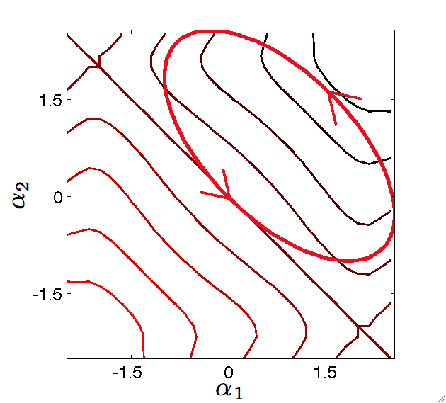
Curl and the Floating Snake
curl
–
+
Encircling a region of negative curl means floating snake rotates negatively

Slide 12
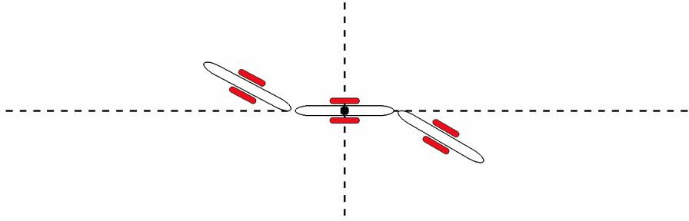
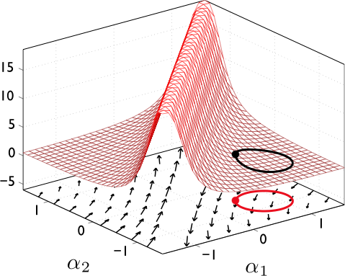
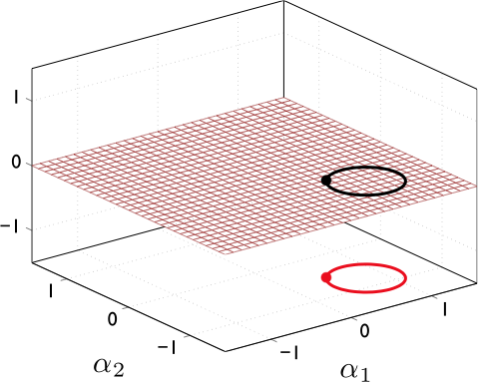
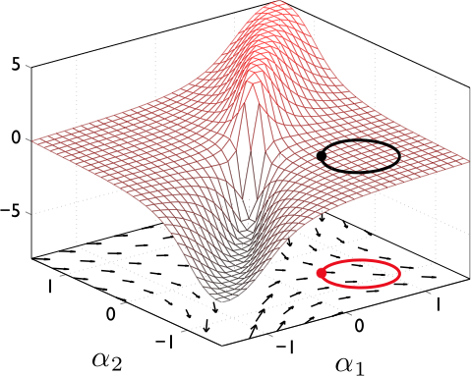
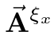
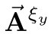
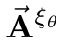
Gaits and Stokes’s theorem
Walsh and Sastry, 1995
Shammas and Choset, 2005
Melli, Rowley and Rufat, 2006
Notes:
Taking this principle to our connection vectorfields and plotting their curls as a function of their shape space, we immediately get some information on the net effect of running a gait. CLICK TO ADVANCE. The gait surrounds equal positive and negative portions of the orientation height function, thus has a zero net integral. This corresponds directly to the fact that the system experiences no net rotation over the course of the gait.

Slide 13
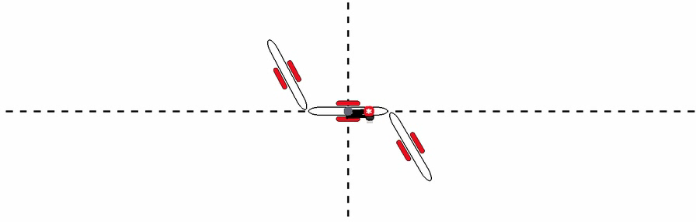
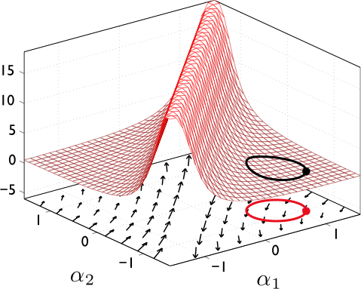
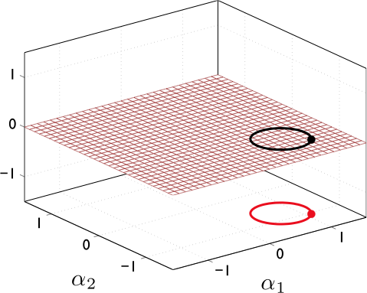
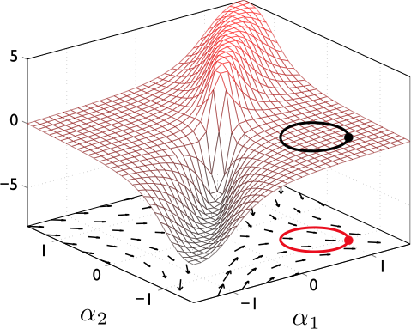
Gaits and Stokes’s theorem
Notes:
Even worse, we cannot find a map from BVI to net displacements. Even the same two cyclic motions (CLICK) but with different starting points result in different displacements. (NEXT SLIDE)

Slide 14
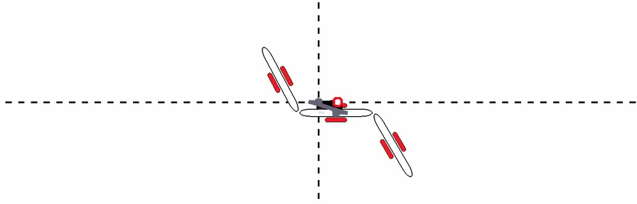
Gaits and Stokes’s theorem
Notes:
Because the enclosed area on the curve is the same, we still have the same BVI. But the displacement is different because, what happens here is that the order of when we translate and rotate changes producing a different translations

Slide 15
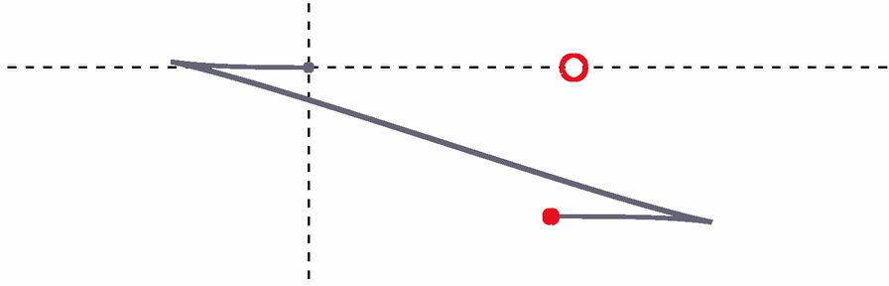
Gaits and Stokes’s theorem
Notes:
In fact, there is a whole locus of displacements, each corresponding to different starting points on the same cycle. (CLICK) each of which correspond to different sequences of translations and rotations

Slide 16
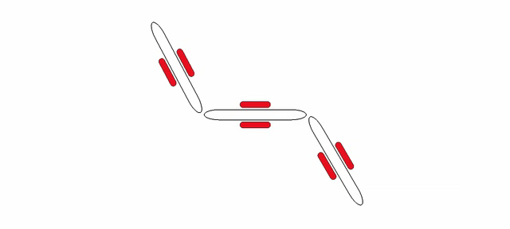
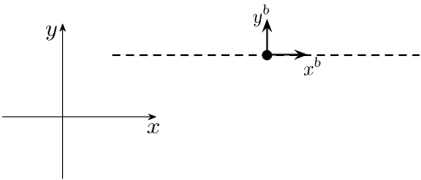
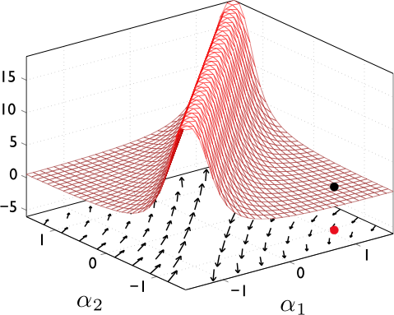
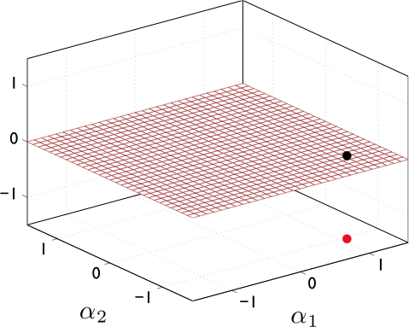
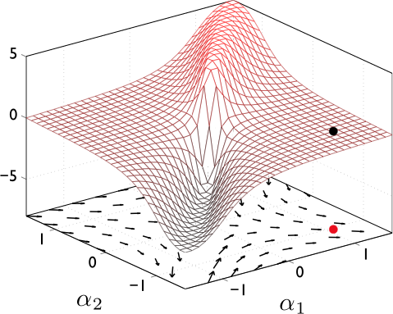
Mean Orientation
Notes:
Now something special happens. If we change our coordinate system so that orientation is now the mean orientation of the three links, rather the orientaiton of the middle link, (CLICK) and the run the same cyclic motions (ADVANCE)

Slide 17
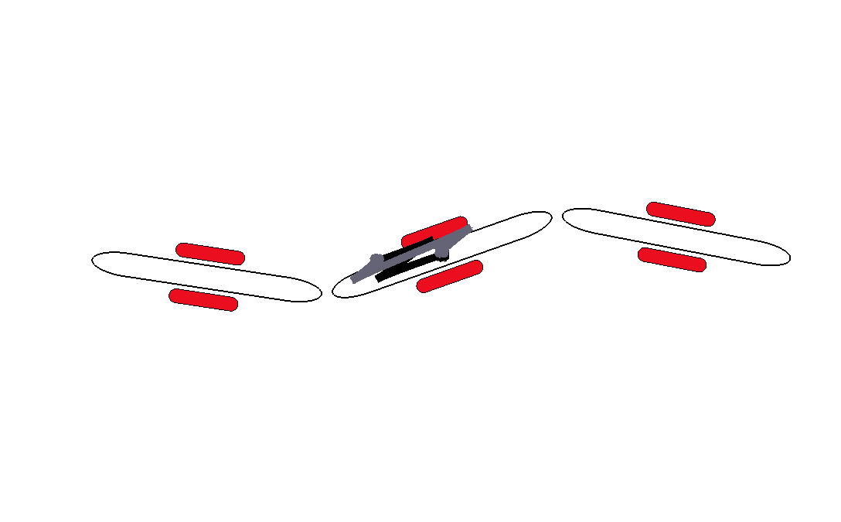
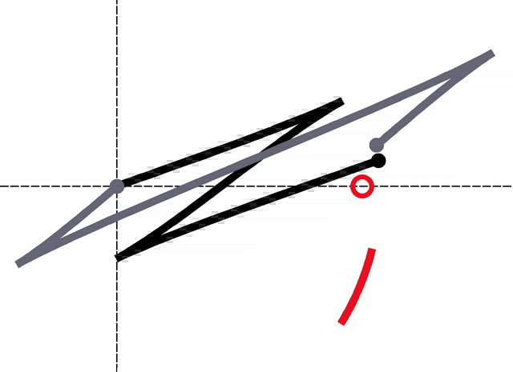
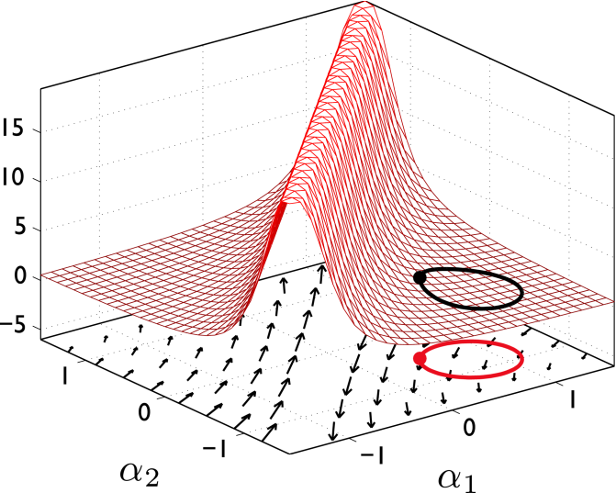
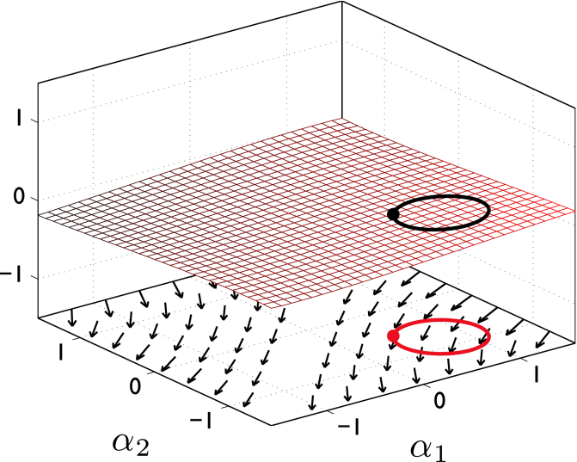
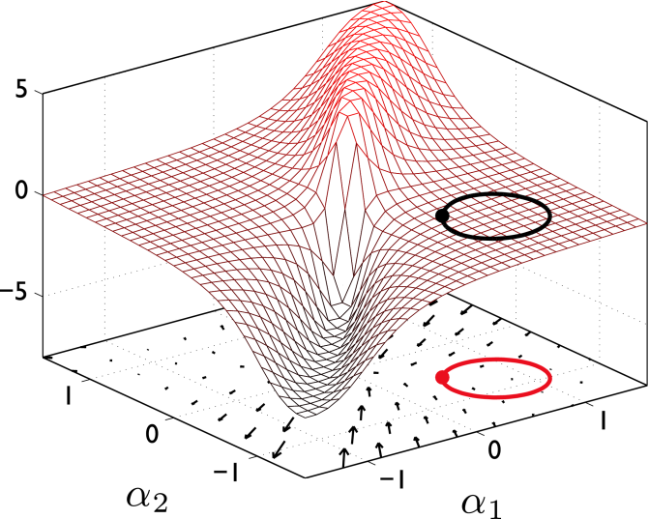
Mean Orientation
Notes:
We see that the two representative cycles we showed previously have net displacements closer to each other (ADVANCE)

Slide 18
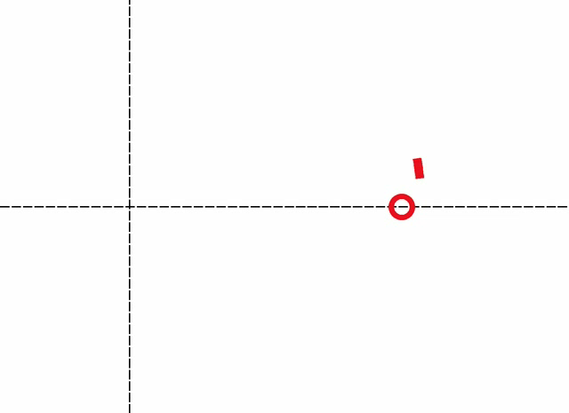
Mean Orientation
Notes:
And in fact, the whole locus of possible displacements is much smallers. Further the BVI is much closer to this locus of displacements – CLICK to move circle closer to line.

Slide 19
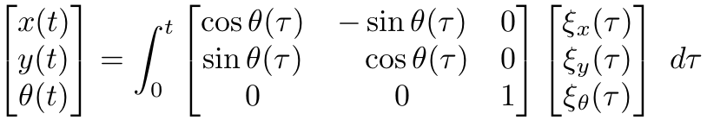
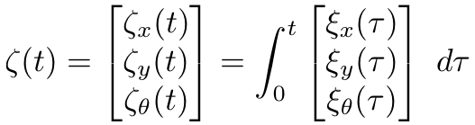
Displacement
Body Velocity
Integral (BVI)
Notes:
To understand this discrepancy, we need to point out the two ways of integrating the motion of the system. The first is the standard displacement measure where we calculate the body velocity at each instant, rotate it into the world frame and integrate. INTUITION!! INTUJITION INTUITIOJ!

Slide 20
Available coordinate choices?
Good coordinate choice?
What about Non-commutivity?
Notes:
Can we do better? This raises these two questions

Slide 21
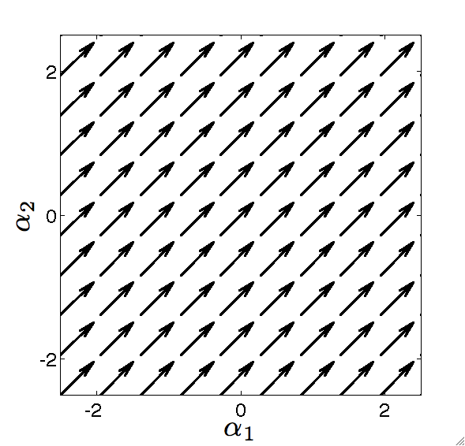
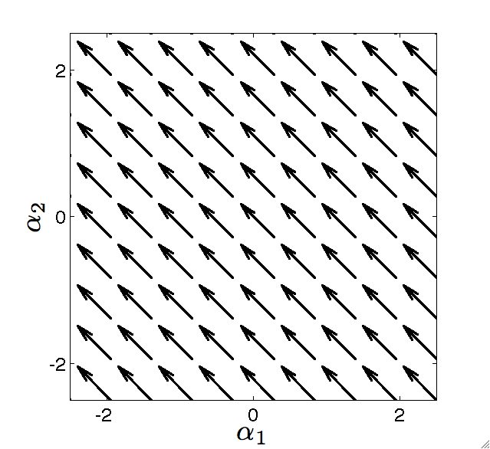
Noncommutativity
Car cannot move sideways, but, because translations and rotations do not commute, it can “parallel park” to get a net lateral motion
curl
curl
None of this shows up in the curl

Slide 22
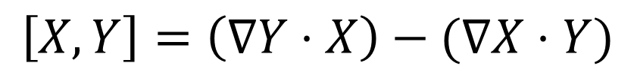
Lie Brackets
Lie bracket measures how vector fields change along each other
Directional derivative of Y along X
Directional derivative of X along Y
Lie bracket
$$\left[X,Y\right]=\left(∇Y⋅X\right)−(∇X⋅Y)$$
Output of the Lie bracket of two vector fields is a vector field. At each point, differentially flowing along X, Y, -X, and –Y (in order) is equivalent to flowing along [X,Y] for equal time
When we have a Lie group, we can talk about the Lie bracket of two vectors u,v in T_{e}G as meaning the Lie bracket of their left-invariant fields, evaluated at the origin
When we do this, we are treating T_{e}G as the Lie algebra of the group

Slide 23
Lie bracket on SE(2)
Lie group Lie bracket
SE(2) Lie bracket

Slide 24
Lie Bracket and the Car
Differential drive car
Drive forward
Turn in place
Drive+, turn+, drive-
This is called (Lie bracket) averaging – if you alternate between differentially moving forward/backward and rotating cw/ccw, on average you move laterally

Slide 25
Importance of Lie brackets
1. Controlability: DO WE WANT TO MORE FORMALLY DEFINE CONTROLLABILITY AND/OR ITS RELATIVES ON THE NEXT SLIDE? Nonholonomically-constrained systems by definition cannot instantaneously move in some directions: their distributions do not span their configuration spaces
If we take a distribution DID WE DEFINE A DISTRIBUTION YET? PERHAPS WE SHOULD REMIND PEOPLE HERE
D={V₁,V₂}
and find that the Lie bracket [V₁,V₂] is outside the span of D, we can combine D with the Lie bracket field to make a new distribution
D’={v₁,v_{2,} [v₁,v₂]}
whose span is one dimension higher, and represents the directions the system can move either with a differential control input or with a first order oscillation I WOULD LIKE TO CALL OUT WHAT WE MEAN BY AN OSCILLATION BUT PERHAPS JUST SPOKEN WORDS IS ENOUGH of the controls. In some cases, we can further expand the distribution with higher-order Lie brackets, e.g.,
D’’ = {v₁,v_{2,} [v₁,v₂], [v₁, [v₁,v₂]]}
If we reach a point where we can’t add dimensions – YOU MEAN REACH THE FULL DIMENSION by taking more Lie brackets, this is an involutive distribution: it describes the full set of directions in which the system can move differentially. If a system’s involutive distribution spans the whole configuration space, then the system is said to be controllable – we have a set of inputs that can move the system in any direction. (Note that in general there will be more efficient/effective ways to move the system in non-primary directions, controllability is a proof of existence)

Slide 26
Importance of Lie brackets
2. Relationship to gaits.
are associated with unit shape velocities,
and so their Lie bracket corresponds to the motion produced by a differential oscillation in the shape space (i.e. a differential gait)
SHOULD WE RELATE TO DIFF DRIVE? WHAT ARE ALPHA 1 and 2

Slide 27
Lie Bracket and Larger Motions
We switched from u’s and v’s to alpha’s
One of the nice things about thinking of Lie bracket motions as differential gaits is that it gives us intuition as to how the system will move over larger gaits: Two differential cycles are equivalent to their combined perimeter if the overlapping edges cancel out.
This gives us an area rule: over a larger gait, magnitude of average flow field is the area integral of the Lie bracket over the region enclosed by the gait – I FEEL AREA COMES OUT OF NOWHERE? Why can we talk about area?
Example: Increasing forward translation and rotation each linearly increases the lateral translation
This rule is consistent with the Lie bracket as a bilinear operator – it scales linearly with u and v.
Note that here there is a small-angle condition on this assumption, and we are also assuming that local connection is constant (and thus that input fields are left invariant) – EXPLAIN LOCAL CONNECTION IS CONSTANT
Notes:
If the contribution of motion comes solely from the nonconservative contribution, then the adding of arm is exact, if there is some noncommutative contribution, then it is approximate
The little black square is an area. Look at the figure below – the size of the go forward in x and go forward in theta mulitplies together like an area.
The approximation is like a lie bracket of a lie bracket

Slide 28
Lie Brackets and Exponential Maps
Lie bracket gives us average velocity of the system: moving for dt along each of u, v, -u, and -v is equivalent to moving for dt along [u,v]. (note that the total “time” in the cycle is different from the “flow time” along the Lie bracket field).
To get the displacement over the cycle, we can exponentiate this velocity: CAN YOU REMIND ME AGAIN WHEN THE EXPONENTIAL IS RELATED TO A GROUP OPERATOR; IS THIS TRUE FOR ALL LIE GROUPS, IE IS THE DEFINING FEATUER OF LIE GROUPS
Note: still making small angle approximations
Here, [u,v]dt gives the exponential coordinates of the net displacement, In the future, we will denote such exponential coordinates as z.
Also note that if we scale u or v, we proportionally increase the displacement
Notes:
This is a average of velocities. To make it a displacement, you map out.

Slide 29
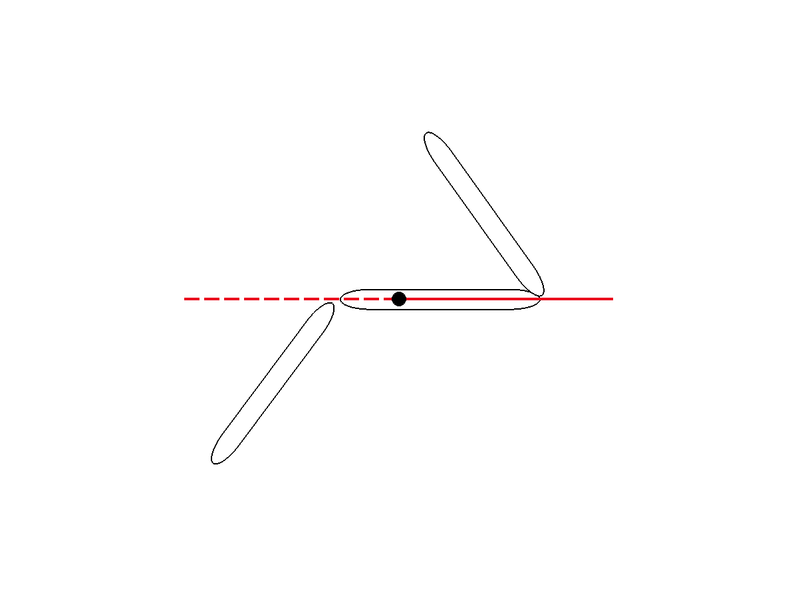
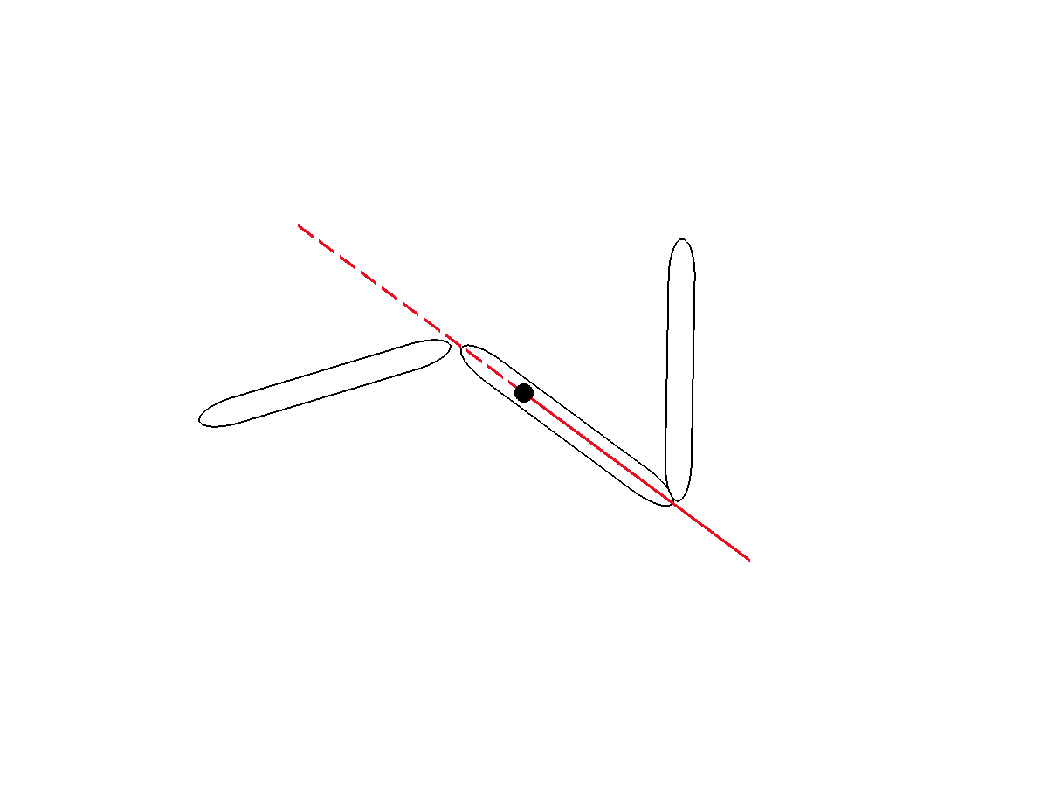
Nonconservativity
Noncommutatvity
curl
–
+
Curl and Lie bracket look very similar. Up next, we combine them into a single concept

Slide 30
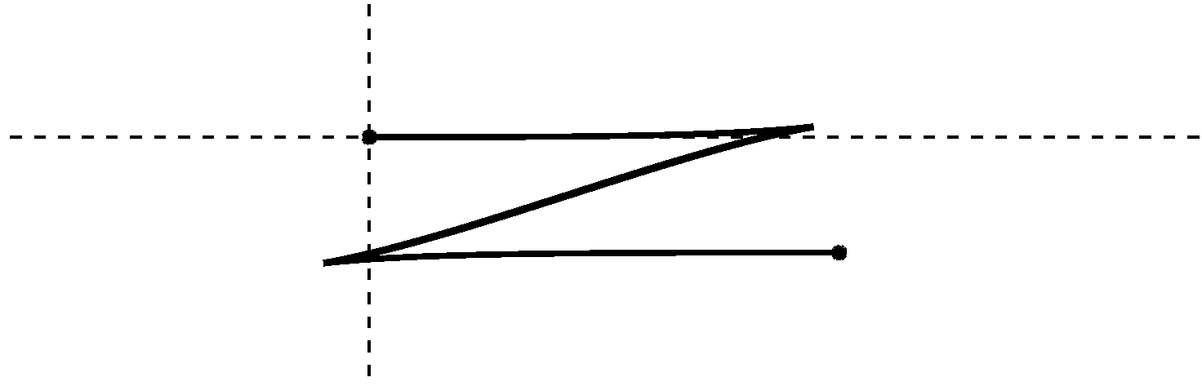
Combining Nonconservativity and Noncommutativity
Example: Kinematic snake combines both effects – curl of the connection vector field means the system moves forward more than backward, noncommutativity means it also moves laterally

Slide 31
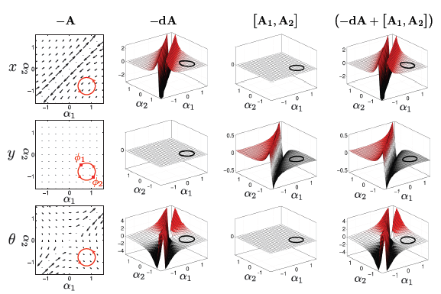
Nonconservativity + Noncomunitativity

Slide 32
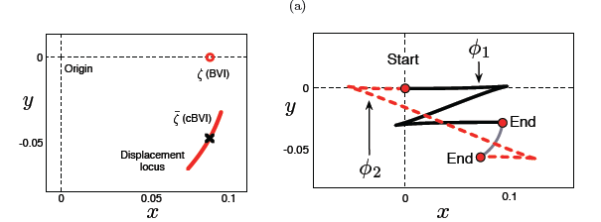
Without and with

Slide 33
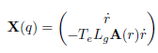
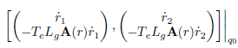
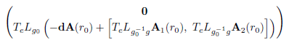
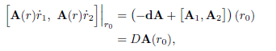
Lets take a step back

Slide 34
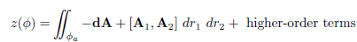
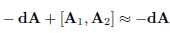
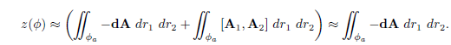
Still just an approximation

Slide 35
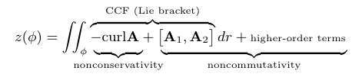
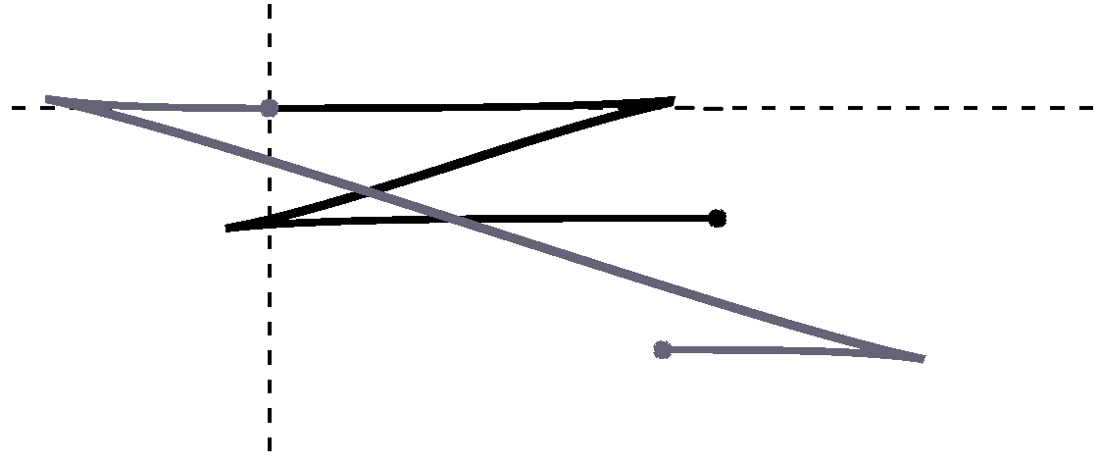
What does this series mean?
Notes:
Here we have two paths that correspond to the same cycle motion but different starting points. The first term corresponds to the curl of the location connection, which tells us how much the system moves forward minus backward along each BODY coordinate direction, x, y and theta, ie how nonconservative the vectorfields are. <CLICK>
[videos of this to come if draft is good]
Nonconservativity: how far the system moves forward and backward (Stokes Theorem), gives the average body velocity.
Noncommutativity I: cyclic ordering, parallel parking effect. Modifies the average body velocity to approximate the average absolute velocity as seen from the starting position.
Noncommutativity II: full ordering. Further modifies the average velocity to bring it closer to the average absolute velocity as seen from the starting position. This causes a starting-shape-dependent spread in the net displacement
Key takeaway: Truncating at first two terms makes displacement calculation equivalent to taking an area integral

Slide 36
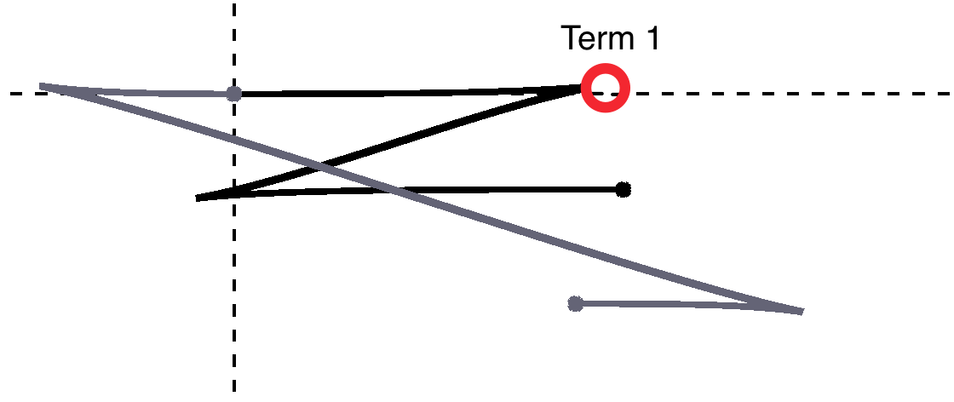
What does this series mean?
Notes:
The second term corresponds to how much the system is biased because of the order of turning and translating,, ie how noncommutitive the position space is
[videos of this to come if draft is good]
Nonconservativity: how far the system moves forward and backward (Stokes Theorem), gives the average body velocity.
Noncommutativity I: cyclic ordering, parallel parking effect. Modifies the average body velocity to approximate the average absolute velocity as seen from the starting position.
Noncommutativity II: full ordering. Further modifies the average velocity to bring it closer to the average absolute velocity as seen from the starting position. This causes a starting-shape-dependent spread in the net displacement
Key takeaway: Truncating at first two terms makes displacement calculation equivalent to taking an area integral

Slide 37
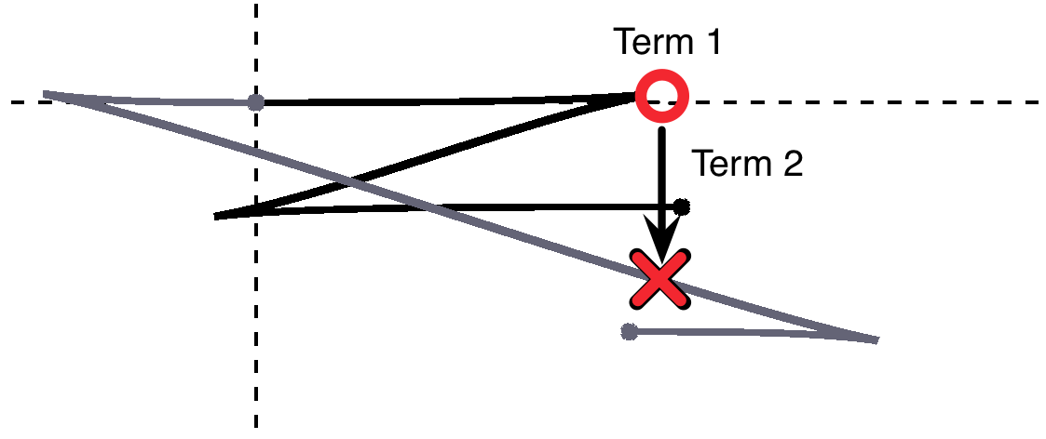
What does this series mean?
Notes:
The higher order terms capture the effects of the full ordering, so if turning comes very early or very late, then you would have less bias in the overall motion. Therefore, the higher order terms capture the different start and final shape configurations of the robot. Unfortunatley, since it is based on the starting point, it does not look like an area term.
[videos of this to come if draft is good]
Nonconservativity: how far the system moves forward and backward (Stokes Theorem), gives the average body velocity.
Noncommutativity I: cyclic ordering, parallel parking effect. Modifies the average body velocity to approximate the average absolute velocity as seen from the starting position.
Noncommutativity II: full ordering. Further modifies the average velocity to bring it closer to the average absolute velocity as seen from the starting position. This causes a starting-shape-dependent spread in the net displacement
Key takeaway: Truncating at first two terms makes displacement calculation equivalent to taking an area integral

Slide 38

What does this series mean?
Notes:
[videos of this to come if draft is good]
Nonconservativity: how far the system moves forward and backward (Stokes Theorem), gives the average body velocity.
Noncommutativity I: cyclic ordering, parallel parking effect. Modifies the average body velocity to approximate the average absolute velocity as seen from the starting position.
Noncommutativity II: full ordering. Further modifies the average velocity to bring it closer to the average absolute velocity as seen from the starting position. This causes a starting-shape-dependent spread in the net displacement
Key takeaway: Truncating at first two terms makes displacement calculation equivalent to taking an area integral

Slide 39


Coordinate optimization
Accuracy and span is improved if we use mean-orientation coordinates
Notes:
System’s overall orientation is much more consistent over different starting shapes, so net direction of travel is more consistent. Computationally, the mean-orientation frame rotates less, so the higher order terms in the series become smaller (the information they would contain is projected back into the lower terms)

Slide 40


Available coordinate choices
Valid body frame if
(and only if)
Notes:
To answer the first questions, without any details, if we have a valid body frame for the system, we know that all other valid body frames are a shape dependent transform away from it.

Slide 41





Effect of changing coordinates
Notes:
If we look at the effect of changing the coordiantes, we can see the new body velocity <CLICK> is the sum of the original body velocity <CLICK> the relative velcoities of the two frames <CLICK> and a cross product term which determines the translation of the new frame caused by the rotation of the original frame <click> and then there is a rotation matrix that rotates the velocity from the original frame to the new frame. <CLICK>

Slide 42







New velocity for mean orientation
Notes:
If we apply this change of coordinates to the mean frame, we can see that the cross product term drops out because we have not changed the reference point <CLICK> the relative velocity term, likewise, drops out for the x and y directions <CLICK> HOWIE WILL SAY, at this point, we will only worry about the rotation part of the equation… The rotation matrix does not change the magnitude of the velocities, just their directions, and therefore only affects the computation, it does not affect the representation of the system <CLICK> HERE IS WHY WE CAN WAVE HANDS

Slide 43







New rotational vector field
Notes:
Sio, the x and y coordinates are still the same and it is the orientation that has changed. The new rotational velocity is the sum of the original rotational velocity and the relative rotational velocities of the old and new frames. We can see that each of these vel terms are the dot product of the vectorfield over the shape space with the shape velocity vector. So we can substitute a summation of vectorviews for the sumation of velocities. The third vectorfield is the gradient of the change of orientation with respect to shape. <ADNVACE>

Slide 44







New rotational vector field
Notes:
To calculate the gradient of the change of coordinates, we can start by observing for the mean orientation, we can take the orientation of the three links, average them, note the orientation of the first and third links are each the orientation of the middle link plus or minus the intervening joint angle. <CLICK>

Slide 45


New rotational vector field
change of orientation
gradient with respect to shape
Notes:
And by substituting these expressions for theta 1 and 3 into our expression for theta new, and collecting the theta 2 terms then we see that the change in orientation, beta_theta, ie the difference between thetanew and theta2 is just a function of the joint angles, for which we can easily take the gradient, which results in a constant vectorfield -1/3 1/3.

Slide 46



New rotational vector field
Notes:
If we plot these vectorfields, we can see that in the second and fourth quadrants (CLICK) the original vectorfield lies opposite to the change of coordinates <CLICK> such that their sum is approximately null in that region. <CLICK>

Slide 47



Orientation during gait
Original
Mean
Notes:
If we look at the change of orientation of the example gait in the two coordiantes, then we can see that the nullification results in the rotational velocity being small and its overall maximum ORIENTATION displacement likewise shrinking, which gives us the approximate identity between the BVI and the true displacement when using the mean orietnation

Slide 48






Optimal orientation
Find
that minimizes
Notes:
Based on this obsdervation, we can find the optimal orientation as the change of orientation that minimizes the average sum of the original and the change of orientation vectorfield fields, thus minumizing the new orientation vectorfield.

Slide 49



Hodge-Helmholtz Decomposition
Same Curl
Original
Closest Gradient
Original
= Same Curl +
Closest Gradient
Notes:
To solve this minimization, we turn to the hodget helmoltz decomposition – gives you a curl free field and a divergece free field. The curl free field is the “closest” gradient to the original field. The divergence free field has the same curl but with smallest average square magnitude. (NOTE TO HOWIE the closest gradient vectorfield is the one out of the set of all gradient vectorfields is the closest to the original). Sometimes there is a residual amount of divergence in our nominally divergence free field in our implementation due to the fact that we ar enot working with infinite extend vectorfields.

Slide 50




Optimal orientation
Find
that minimizes
Same Curl
-Closest Gradient

Slide 51


Optimal vs. Mean Orientation
Optimal
Mean

Slide 52




Orientation during gait
Original
Mean
Optimal

Slide 53

BVI–Displacement Error
Notes:
Now, we are going to start caring about coordinate changes that can effect the change in magnitude of xi_x and xi_y.

Slide 54




Optimal position
Find
and
that minimize

Slide 55




Optimal position
Optimal
Center of mass

Slide 56




Optimal coordinates

Slide 57

Optimal coordinates

Slide 58

Optimal coordinates

Slide 59

Generality
Gaits with BVI error less than 10%

Slide 60



Floating snake
Center of Mass
Time

Slide 61



Floating snake
Time

Slide 62


Slide 63

Trajectory comparison

Slide 64

Coordinate optimization
Black: Displacement magnitude and span
Grey: Original area integration
Red: Optimized area integration and displacement span
Stroke Amplitude
Notes:
In optimized coordinates, area integ – ral matches displacement, and span of displacements is much smaller – note lead in to next figure - first higher term is spread and second higher term gives us displacemnt peak

Slide 65


Slide 66

Snakes on a Plan (Hatton, Knepper, Travers, Droge, Egerstedt)
Gait | Velocity | Power | Efficiency
Slither (longitudinal) | 2.8 cm/sec | 13.1 W | 130.2 mWh/m
Rolling (transverse) | 26.4 cm/sec | 28.7 W | 30.2 mWh/m
Rotate | 22.5 deg/sec | 29.0 W | 0.481 mWh/deg
Transition between gaits | 0 cm/sec (lasts 1 sec) | 28.5 W | 0 mWh/m (costs 3.65 mWh)
Separate position and internal shape variables
Plan for position and “almost” defer shape variables until execution
Chose position variables based on “best gait”
Discrete Planner: sample position (rectangle), extend straight line, maximize efficiency and satisfy constraints

Slide 67


Towards Simple Motion Models
Plan for snake robots in much the same way as we already do with wheeled robots
Intuitive relationship between rotation of the wheels and motion of the chassis.
Notes:
DISCUSSION: Be careful about loaded terminology. Don’t say the snake is like a wheel
Look at the snake much in the same way we would look at wheeled robots. This naturally makes planning easier
ROSS: 1. Basic no-slip constraints let us make a simple model that includes forward+turn. 2. Having this model makes planning simple. 3. For the snake robots we want an equivalent ‘directional drive’ model.
TEXT I DELETED FROM SLIDE
With wheeled robots we have a basic no-slip / no-slide model that gives an intuitive relationship between rotation of the wheels and motion of the chassis.
We would like work with snake robots in much the same way as we already do with wheeled robots.
Pick directions and drive those directions.
Do not need to move an integer number of cycles.
DAVE: My overall philosophy is to start to treat the snake like we do with simple wheeled robots. In general I want to assume contact rather than explicitly model it (like what is usually done in wheeled robots where the ground contact model is simple). In a simple case we assume no-slip on the wheels (naïve but often good enough) and can then complexity to our motion models as needed.

Slide 68


Virtual Chasis
Once again, choice of body frame matter
Fixed to a link is bad
(but easy to define)
Based on shape is good
(but more calculations)
Notes:
There is no reason to not use a fixed frame. It is easy. For a lot of robots, such as single rigid body robots, it makes the most sense. However, for our robot, it would give the impression that the whole snake is pirouetting around the first link. That is not representative of the motion in the real world. When we use a frame, say one based on the shape, one can produce a more intuitive motion.
DAVE: The first argument that I use for using the VC is saying that intuition is important. On this slide talk about how we want a frame where up-down, forward-back, left-right are clearly defined.

Slide 69



Compute Virtual Chassis
Optimal Coordinate from before minimizes orientation variation
Approximate: Align with principal shape components via SVD.
Pipes: Exploit symmetry to further align the frame with the centerline of the robot’s shape.
Notes:
Use position of all modules with respect to anything, say the first link.
Numerical stability may be better if you do this off of the center link. Regardless, determine the center of mass and then from a frame whose origin is at the CoM, do the SVD, ie we are calculating the principle moments of inertia about the center of mass.
DAVE: The idea of the virtual chassis is to align a frame with the shape of the system, even as that shape changes. In practice this can mean using the geometric center of mass and principal moments of inertia. This general approach uses SVD to quickly identify the principal components of the snake’s shape. If we have more constraints we can refine further using non-linear minimization (like finding the centerline of the snake’s helix for pipes / poles.

Slide 70

Benefits of Virtual Chassis
“Straighter” paths in the world while executing gaits.
Direction of displacement is independent of starting phase in the gait
Can alter bounding boxes on the fly
Plan for other terrains
Open Issues
Need to implement
Transitions
Non-gait motions

Slide 71
Combining Nonconservativity and Noncommutativity
Is it legitimate to just add nonconservative and noncommutative elements together?
Yes (as an approximation)
Exponential coordinates (average velocity for normalized time) of net displacement over a cycle are in general
[A₁,A₂] is the local Lie bracket, as if A did not change with r
d is the exterior derivative, which is like the curl, but more technically correct for talking about covectors
Higher order terms are linearizaton error in local Lie bracket, and noncommutativity interacting with nonconservativity

Slide 73
Derivation for this equivalence
Full Lie bracket on the configuration space
Differential cycle in the shape space is
Conditions we can apply for these shape inputs:
(T_{e}L_{g} is independent of r)
and
(shape input vector field components are constant)
Top half of full Lie bracket is thus zero, which makes sense: over a cycle in the shape space, there should be no residual change of shape
(A is independent of g)

Slide 74
Derivation, continued
(based condition from last slide)

Slide 75
Derivation, concluded
Collecting all terms gives us
(This is the curl/exterior derivative)
(Make g₀=e)
(Recognize this as an SE(2) Lie bracket)
Net result: nonconservative and noncommutative terms both appear in total Lie bracket
This is the curvature form for the connection, DA

